Slide 1
ECOMMERCE WEBSITE/WEBAPP
Here is our presentation begins

Slide 2
TABLE OF CONTENTS
01
02
03
04
05
06
Html Basic
CSS Intermediate
Bootstrap 4
HyperText Markup Language
Cascading Style Sheets is used to style and layout web pages
Bootstrap is a potent front-end framework used to create modern websites
JavaScript
jQuery
Django
JavaScript is used to create dynamic content
It is a lightweight, "write less, do more", JavaScript library
It is used for back-end with python modules

Slide 3
“If Someone is giving you some Inspiring words , then do’nt do it.”
—ELON MUSK

Slide 4
MISSION STATEMENT
Aim is to resolve the real time problem during pandemic crises, also help small scale venedors to grow their businesses.😊

Slide 5
OUR TEAM
Yash (CSE-C)
Arnav Chaturvedi (CSE-A)
Logo

Slide 6
01
PROJECT OVERVIEW

Slide 7
PROBLEM VS SOLUTION
PROBLEM
SOLUTION
There is no platform available for vendors, where they can connect with other customers.
We made a platform for them, so that anyone of them can come across & showcase their business at scalable level.

Slide 8
COMPETITORS
Wordpress
Blogger.com
E-commerce template website
WordPress is a free, open-source website creation platform
Publish your passions your way
Start your Business with template websites

Slide 9
THEM VS US
THEM
US
MORE COST
DIFFICULT TO MODIFY
LOW COST
EASY TO MODIFY

Slide 10
1,200,000
Big numbers catch your audience’s attention

Slide 11
02
PROJECT ANALYSIS & COMPETITION

Slide 12
Targeted Audience
If we make a project and it doesn’t makes a change for the targeted audience then you can't use the language or address the pain points that mean the most to them ,so people to which this project will be beneficial are:
Street Vendors()
Kiosks(A small shops)
Small stores
And the most important thing: According to a website www.indiaspend.com there are approximately 10 million street vendors in our country
Keep it short and simple

Slide 13
COMPETITION ANALYSIS
 | Low cost | Modify | UI/UX Exp. | B2C/B2B
OUR PROJECT
COMPETITOR 01
COMPETITOR 02

Slide 14
03
SYSTEM REQUIREMENTS

Slide 15
OUR SYSTEM REQUIREMENTS
WEB BROWSER
OS
Google Chrome, Internet Explorer, Mozilla Firefox, etc.
Windows 8,8.1,10,11, Mac, Linux.
MEMORY
INTERNET
Min. space required to store Backend data and at least 2 GB of Ram.
Internet speed should be 1Mbps.

Slide 16
MAIN DISTRIBUTION OF WEBSITE
CHANNEL 1
Shop => home/ , tracker/ , checkout/ , about/ , product/ ,
Addtocart/ , thank/
CHANNEL 2
Blog or notice
CHANNEL 3
Login and Authentication
CHANNEL 4
Admin Panel and Distribution

Slide 17
04
OPERATING PLAN

Slide 18
OUR PROCESS
WEEK 3-4
WEEK 6-7
WEEK 1-2
WEEK 5
WEEK 8
Figure out design and logo of company
Using Bootstrap 4 form enhancing UI / UX Experience
Getting Ready all the html content of webpage
Providing Brain to webpage using JavaScript
Setting up all the front end with backend using Django

Slide 19
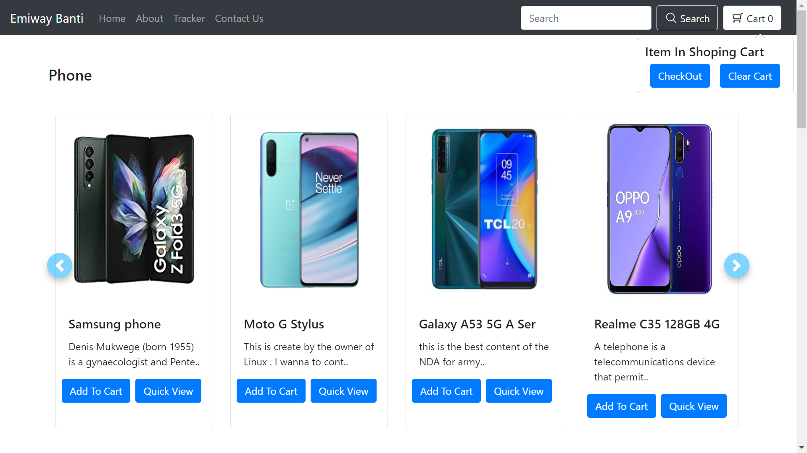
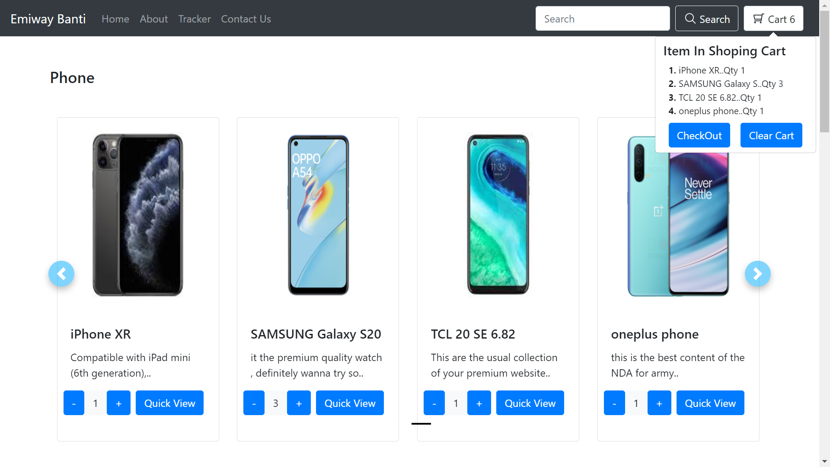
PICTURES OF PROJECT

Slide 20
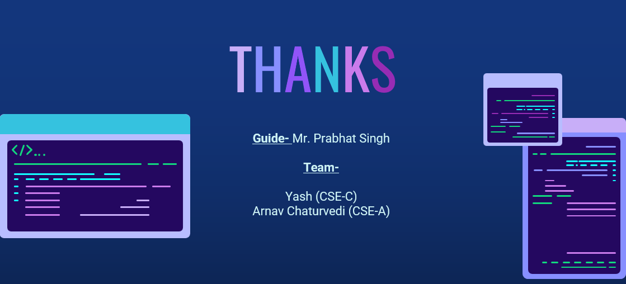
THANKS
Guide- Mr. Prabhat Singh
Team-
Yash (CSE-C)
Arnav Chaturvedi (CSE-A)

